Slide 1
Networking

Slide 2
Describing Network Interface Names
Each network port on a system has a name, which you use to configure and identify it.
Red Hat Enterprise Linux uses names like eth0, eth1, and eth2 for each network interface.
Network interface names start with the type of interface:
Ethernet interfaces begin with en
WLAN interfaces begin with wl
WWAN interfaces begin with ww.

Slide 3
Describing Network Interface Names
oN indicates that this is an onboard device and the server's firmware provided index number N for the device. So eno1 is onboard Ethernet device 1.
sN indicates that this device is in PCI (Peripheral Component Interconnect) hotplug slot N. So ens3 is an Ethernet card in PCI hotplug slot 3.

Slide 4
Describing Network Interface Names
pMsN indicates that this is a PCI device on bus M in slot N.
wlp4s0 is a WLAN card on PCI bus 4 in slot 0.
enp0s1f0 is function 0 of the Ethernet card on bus 0 in slot 1. There might also be a second interface named enp0s1f1 that is function 1 of that same device.

Slide 5
Gathering Network Interface Information
ip link command will list all network interfaces available on your system:
[user@host ~]$ ip link show
1: lo
2: ens3
3: ens4
The server has three network interfaces: lo, which is the loopback device that is connected to the server itself, and two Ethernet interfaces, ens3 and ens4.
Displaying IP Addresses: ip addr show ens3

Slide 6
Gathering Network Interface Information
Ip addr show ens3:
<BROADCAST,MULTICAST,1UP,LOWER_UP> mtu 1500 qdisc pfifo_fast state UP qlen 1000
2link/ether 52:54:00:00:00:0b brd ff:ff:ff:ff:ff:ff
3inet 192.0.2.2/24 brd 192.0.2.255 scope global ens3 valid_lft forever preferred_lft forever
4inet6 2001:db8:0:1:5054:ff:fe00:b/64 scope global valid_lft forever preferred_lft forever
5inet6 fe80::5054:ff:fe00:b/64 scope link valid_lft forever preferred_lft forever

Slide 7
Gathering Network Interface Information
1. An active interface is UP.
2. The link/ether line specifies the hardware (MAC) address of the device.
3. The inet line shows an IPv4 address, its network prefix length, and scope.
4. The inet6 line shows an IPv6 address, its network prefix length, and scope. This address is of global scope and is normally used.
5. This inet6 line shows that the interface has an IPv6 address of link scope that can only be used for communication on the local Ethernet link.

Slide 8
Displaying Performance Statistics
The ip command may also be used to show statistics about network performance.
Counters for each network interface can be used to identify the presence of network issues. The counters record statistics for things like the number of received (RX) and transmitted (TX) packets, packet errors, and packets that were dropped.
[user@host ~]$ ip -s link show ens3

Slide 9
Checking Connectivity Between Hosts
The ping command is used to test connectivity
ping -c3 google.com
The ping6 command is the IPv6 version of ping in Red Hat Enterprise Linux. It communicates over IPv6 and takes IPv6 addresses, but otherwise works like ping.
[user@host ~]$ ping6 2001:db8:0:1::1

Slide 10
Displaying the Routing Table
Use the ip command with the route option to show routing information.
[user@host ~]$ ip route
Add the -6 option to show the IPv6 routing table:
[user@host ~]$ ip -6 route

Slide 11
Tracing Routes Taken by Traffic
To trace the path that network traffic takes to reach a remote host through multiple routers, use either traceroute or tracepath.
This can identify whether an issue is with one of your routers or an intermediate one.
[user@host ~]$ tracepath access.redhat.com
The round trip timing (RTT) and the maximum transmission unit (MTU) size.
The asymm indication means traffic reached that router and returned from that router using different (asymmetric) routes.

Slide 12
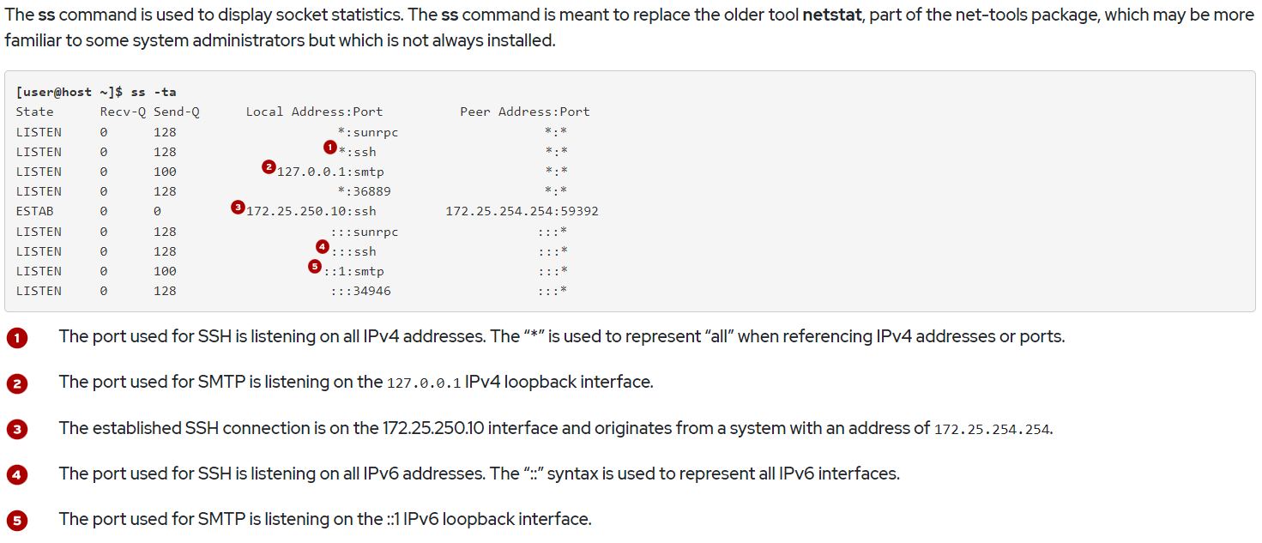
Display socket settings

Slide 13
Configuring Networking from the Command Line
NetworkManager is a daemon that monitors and manages network settings.
Command-line and graphical tools talk to NetworkManager and save configuration files in the /etc/sysconfig/network-scripts directory.
A device is a network interface.
A connection is a collection of settings that can be configured for a device.
Only one connection can be active for any one device at a time.
Multiple connections may exist for use by different devices or to allow a configuration to be altered for the same device

Slide 14

Configuring Networking from the Command Line
Each connection has a name or ID that identifies it.
The nmcli utility is used to create and edit connection files from the command line.
Viewing Networking Information
The nmcli dev status command displays the status of all network devices:
[user@host ~]$ nmcli dev status

Slide 15
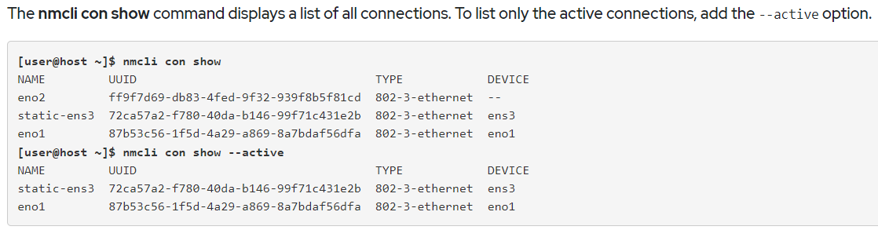
Configuring Networking from the Command Line

Slide 16
Adding a network connection
The nmcli con add command is used to add new network connections.
Add a new connection named eno2 for the interface eno2, which gets IPv4 networking information using DHCP and autoconnects on startup.
It also gets IPv6 networking settings by listening for router advertisements on the local link.
The name of the configuration file is based on the value of the con-name option, eno2, and is saved to the /etc/sysconfig/network-scripts/ifcfg-eno2 file.
[root@host ~]# nmcli con add con-name eno2 type ethernet ifname eno2

Slide 17
Adding a network connection
Create an eno2 connection for the eno2 device with a static IPv4 address, using the IPv4 address and network prefix 192.168.0.5/24 and default gateway 192.168.0.254, but still autoconnects at startup and saves its configuration into the same file.
Note: Due to screen size limitations, terminate the first line with a shell \ escape and complete the command on the next line.
nmcli con add con-name eno3 type ethernet ifname eno3 ipv4.address 192.168.0.5/24 ipv4.gateway 192.168.0.254
OR
nmcli con add con-name eno2 type ethernet ifname eno2 \
ipv4.address 192.168.0.5/24 ipv4.gateway 192.168.0.254

Slide 18
Adding a network connection
Create an eno4 connection for the eno4 device with static IPv6 and IPv4 addresses, using the IPv6 address and network prefix 2001:db8:0:1::c000:207/64 and default IPv6 gateway 2001:db8:0:1::1, and the IPv4 address and network prefix 192.0.2.7/24 and default IPv4 gateway 192.0.2.1, but still autoconnects at startup and saves its configuration into /etc/sysconfig/network-scripts/ifcfg-eno4.
Due to screen size limitations, terminate the first line with a shell \ escape and complete the command on the next line.
[root@host ~]# nmcli con add con-name eno4 type ethernet ifname eno4 ipv6.address 2001:db8:0:1::c000:207/64 ipv6.gateway 2001:db8:0:1::1 ipv4.address 192.0.2.7/24 ipv4.gateway 192.0.2.1

Slide 19
Controlling network connections
The nmcli con up name command activates the connection name on the network interface it is bound to.
Note that the command takes the name of a connection, not the name of the network interface. Remember that the nmcli con show command displays the names of all available connections.
[root@host ~]# nmcli con up static-ens3
The nmcli dev disconnect device command disconnects the network interface device and brings it down. This command can be abbreviated nmcli dev dis device:
[root@host ~]# nmcli dev dis ens3

Slide 20
Controlling network connections
Show all connections.
[student@servera ~]$ nmcli con show
Display only the active connection.
nmcli con show –active
Display all configuration settings for the active connection.
[student@servera ~]$ nmcli con show "Wired connection 1"

Slide 21
Controlling network connections
Show device status.
[student@servera ~]$ nmcli dev status
Display the settings for the enX device.
[student@servera ~]$ nmcli dev show enX

Slide 22
Controlling network connections
Create a static connection with the same IPv4 address, network prefix, and default gateway. Name the new connection static-addr.
sudo nmcli con add con-name "static-addr" ifname enX type ethernet ipv4.method manual
ipv4.address 172.25.250.10/24 ipv4.gateway 172.25.250.254
Modify the new connection to add the DNS setting.
[student@servera ~]$ sudo nmcli con mod "static-addr" ipv4.dns 172.25.250.254
View all connections.
[student@servera ~]$ nmcli con show

Slide 23
Controlling network connections
View the active connection.
[student@servera ~]$ nmcli con show --active
Activate the new static-addr connection.
[student@servera ~]$ sudo nmcli con up "static-addr“
Verify the new active connection.
[student@servera ~]$ nmcli con show --active

Slide 24
Controlling network connections
Configure the original connection so that it does not start at boot, and verify that the static connection is used when the system reboots.
Disable the original connection from autostarting at boot.
[student@servera ~]$ sudo nmcli con mod "Wired connection 1" \
connection.autoconnect no
Reboot the system.
[student@servera ~]$ sudo systemctl reboot

Slide 25
Controlling network connections
Use nmcli dev dis device to deactivate a network interface.
The nmcli con down name command is normally not the best way to deactivate a network interface because it brings down the connection.
However, by default, most wired system connections are configured with autoconnect enabled.
This activates the connection as soon as its network interface is available. Since the connection's network interface is still available, nmcli con down name brings the interface down, but then NetworkManager immediately brings it up again unless the connection is entirely disconnected from the interface.

Slide 26
Network Configuration Files
Each network connection has a configuration file that defines IP assignments and other relevant parameters for it. The networking subsystem reads this file and applies the settings at the time the connection is activated.
Connection configuration files (or connection profiles) are stored in a central location under the directory
/etc/sysconfig/network-scripts/ifcfg-name
The filenames begin with ifcfg- and are followed by the name of the connection.
For example let connection names be ifgcfg-enp0s3,ifcfg-LPU, ifcfg-NS etc.
The final location of configuration file will be:
/etc/sysconfig/network-scripts/ifcfg-enp0s3 (default connection established at the time of system installation)
/etc/sysconfig/network-scripts/ifcfg-LPU
/etc/sysconfig/network-scripts/ifcfg-NS

Slide 27
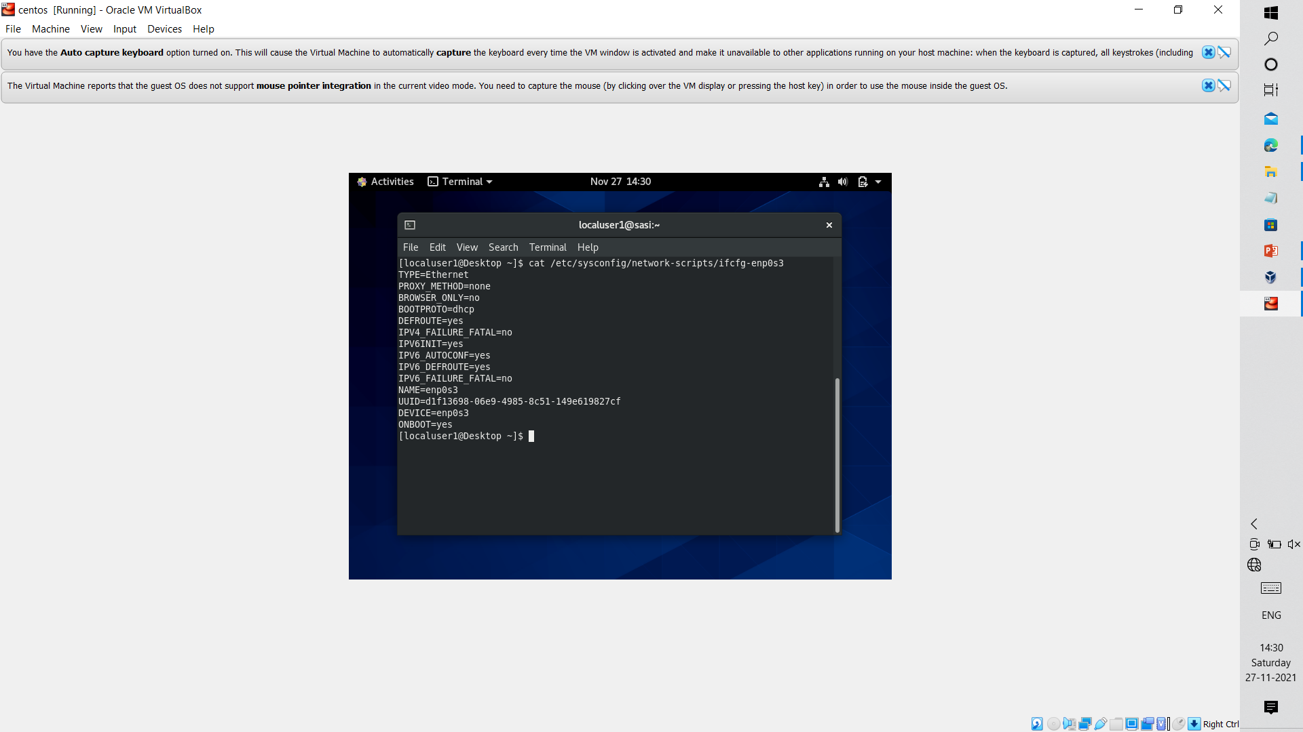
Attributes of Network Configuration File
Whenever we open a network configuration file of a particular file it contains a set of attributes.
The command to open network configuration files:
cat /etc/sysconfig/network-scripts/ifcfg-enp0s3
Output display all attributes.

Slide 29
Network Manager Service
Network Manager is the default interface and connection configuration, administration, and monitoring service used in
RHEL 8. This service has a daemon program called Network Manager, which is responsible for keeping available interfaces and connections up and active.
It offers a powerful command line tool called nmcli to manage interfaces and connections, and to control the service.
In nmci we have two categories of commands:
Connection
- mainly used for changing or modifying attributes of a connection.
- syntax : nmcli connection <operation> <arguments> or
nmcli con <operation> <arguments>
Display
- It is used to display network connections and their status.
- syntax : nmcli device <operation> <arguments> or
nmcli dev <operation> <arguments>

Slide 30
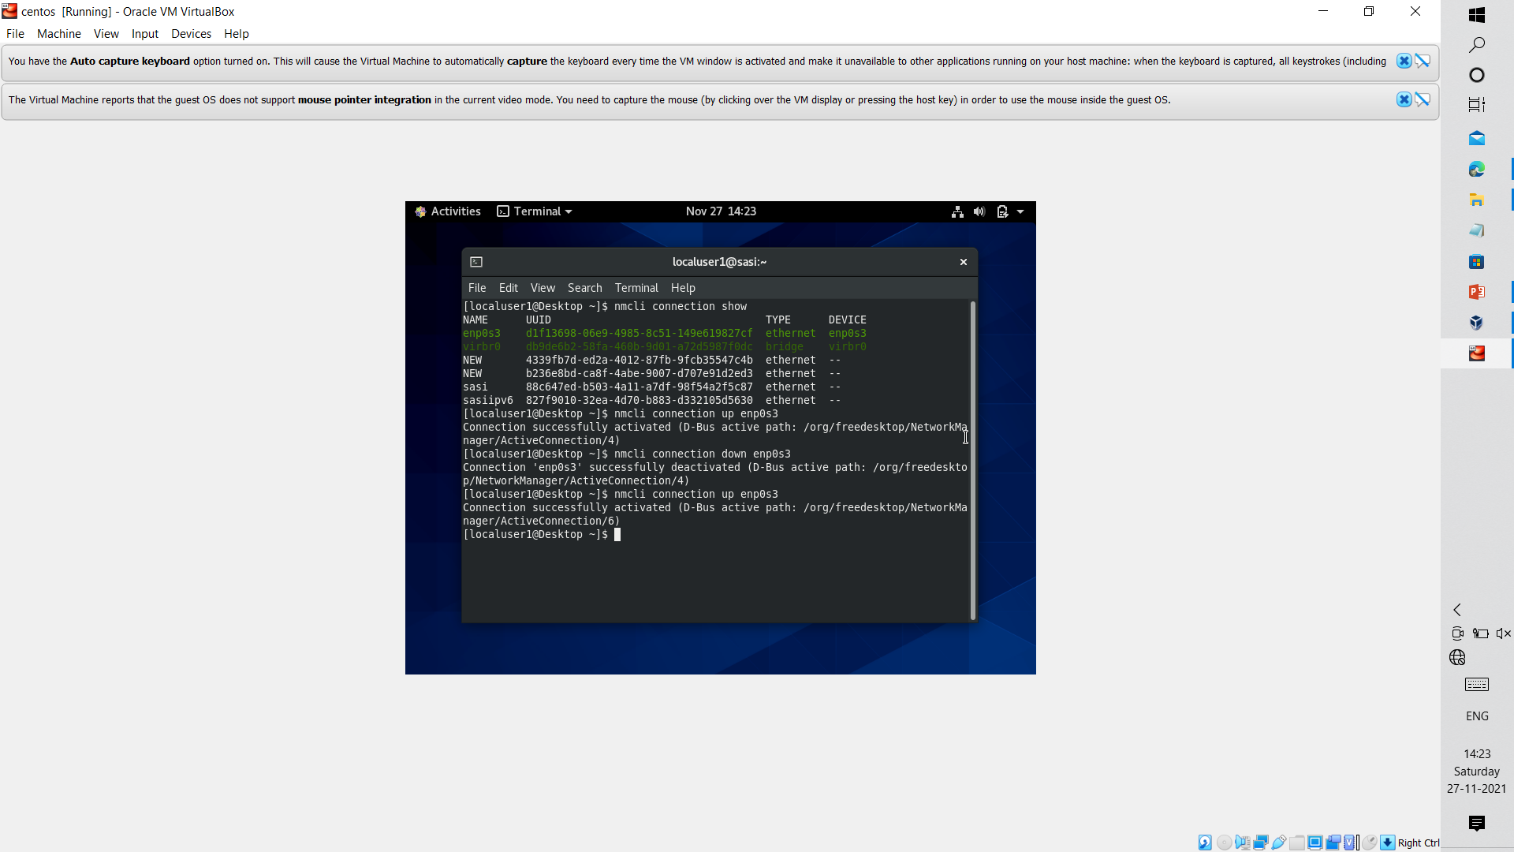
To show all connections which are both active and inactive :
# nmcli connection show
This command show all the connection along with their names and the devices they are attached with it. It also their UUID and type of the network.

Slide 31
To Activate and Deactivate the connection:
To activate connection we use
# nmcli connection up <Connection_Name>
Ex: # nmcli connection up enp0s3
To deactivate the connection we use
# nmcli connection down <Connection_Name>
Ex: # nmcli connection down enp0s3

Slide 32
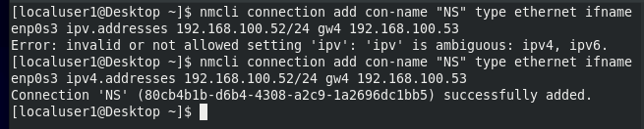
To add new Network Connection
# nmcli connection con-name <name> type <con_type> ifname <interface_name>
ipv4.addresses <ipv4 address> gw4 <gate way address>
Ex: #nmcli connection con-name “NS” type ethernet ifname enp0s3
ipv4.addresses 192.168.100.52/24 gw4 192.164.100.53
This command will add new network of Ethernet type with the given ip address and gate way and using enp0s3 as its network interface card.

Slide 33
When ever a new connection is added the attributes are set to default.
Like BOOTPROTO = dhcp
The main purpose of this is when ever the system is started it fetches default ip address from the DHCP server rather than the static ip address which we have assigned while creating the network or It can be changed to none.

Slide 34
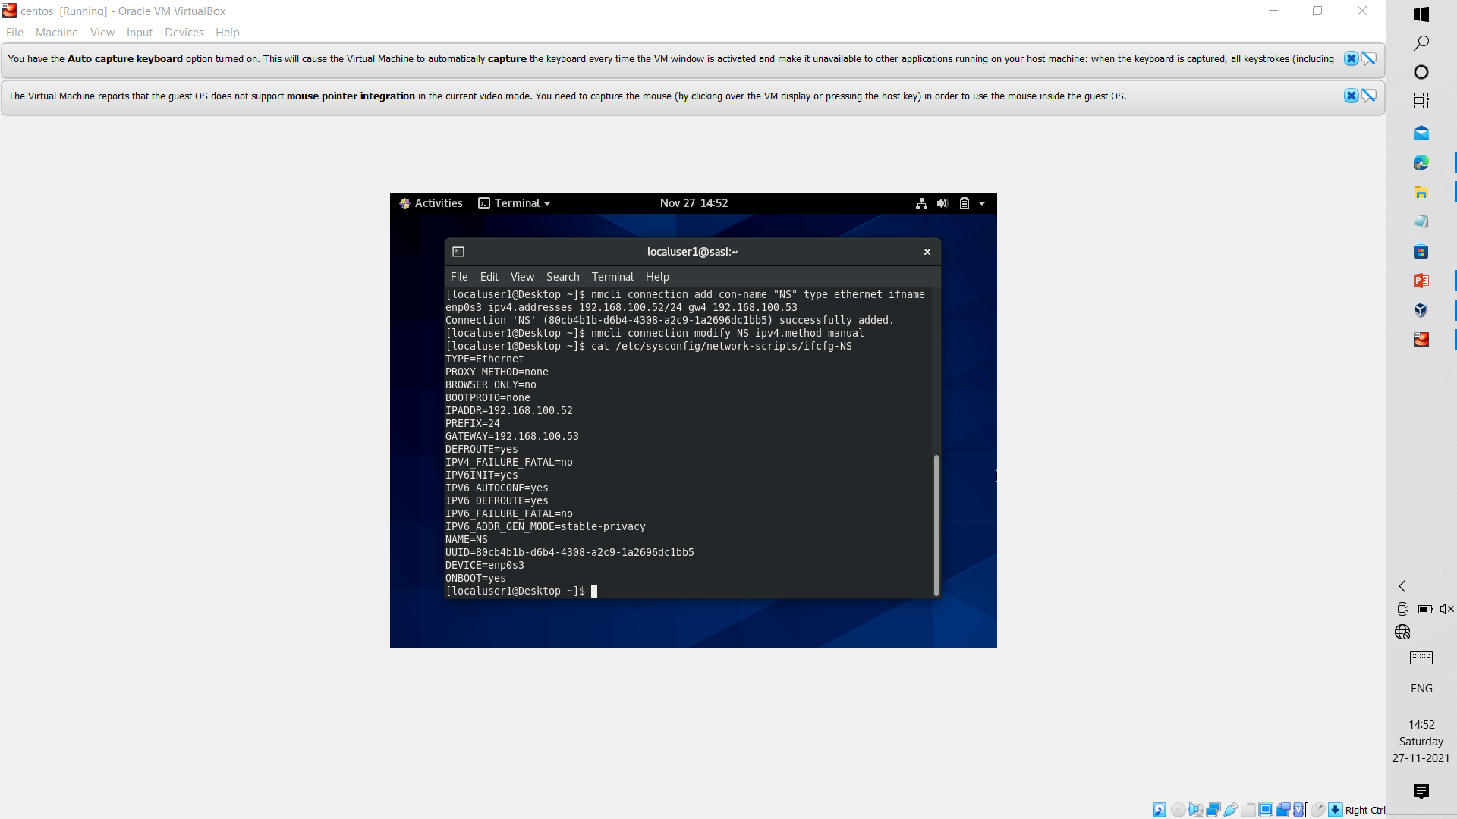
In order to prevent the system from assigning default ip address from DHCP we need to modify this variable to none.
Command to modify this is:
#nmcli connection modify <con_name> ip4.method manual
Ex: #nmcli connection modify NS ipv4.method manual

Slide 35
Attribute ONBOOT = YES:
It makes the connection to auto activate the connection on system boot.
In order to prevent the connection from
activating on boot time we need to change this attribute value to “No”.

Slide 36
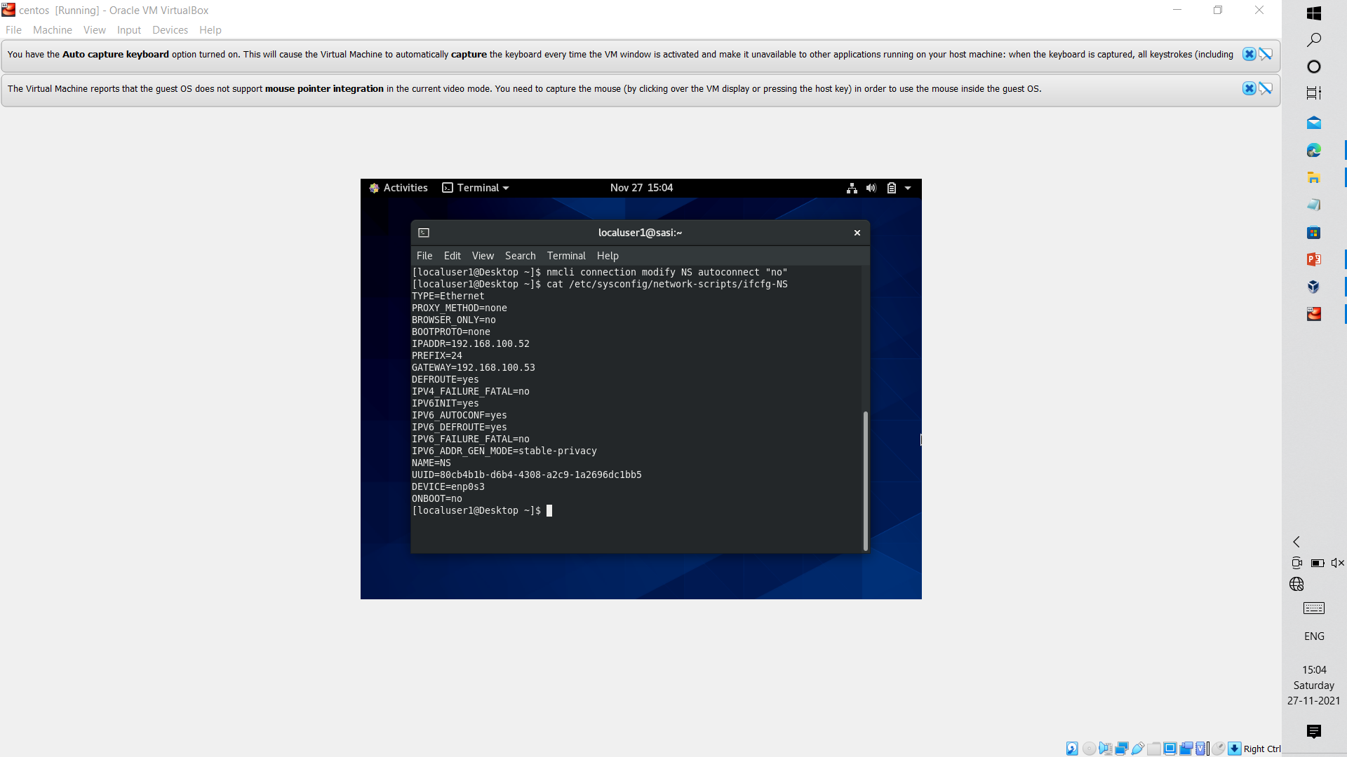
Command to change ONBOOT = NO:
#nmcli connection modify <con_name> autoconnect “no”
Ex: #nmcli connection mmodify NS autoconnect “no”

Slide 37
Changing DNS server:
Our network typically uses default DNS server provided by ISP.
But if we want to change our DNS server we can do by using the following command
#nmcli connection modify <con_name> ipv4.dns <dns_address>
Ex:
#nmcli connection modify NS ipv4.dns 160.162.100.60

Slide 38
Changing DNS server:
We can add multiple DNS to a particular network by using
#nmcli connection modify <con_name> +ipv4.dns <dns_address>
Ex:
#nmcli connection modify NS +ipv4.dns 160.162.100.61
“+” indicates appending new DNS server to exsiting connection.

Slide 39
We can add multiple ip address to a network by using:
#nmcli connection modify <con_name> +ipv4.addresses <ip_address>
Ex:
#nmcli connection modify NS +ipv4.addresses 192.168.100.65/24
We can delete a connection by using delete command:
#nmcli connection delete <con_name>
Ex:
#nmcli connection delete NS

Slide 40
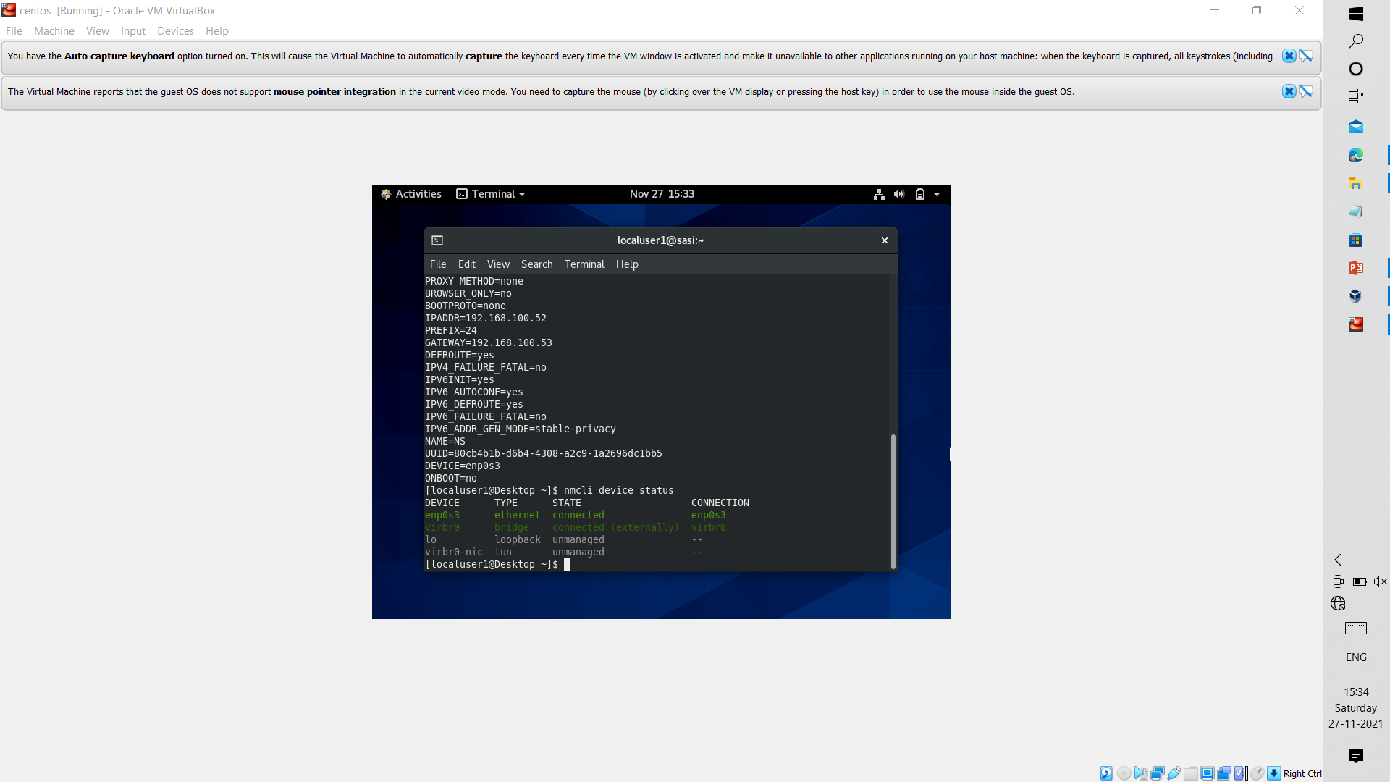
To view the status of all connections we can use status command:
#nmcli device status

Slide 41
Creating ipv6 Network Connection:
It is same as creating ipv4 connection but instead we use ip6.addresses and gw6 here
#nmcli connection add con-name “NS_ipv6” type ethernet ifname enp0s3 ipv6.addresses 2001:0bd8:0:1:0::1/64
gw6 2001:0bd8:0:1:0::2/64
Similary we change ONBOOT by
#nmcli connection modify NS_ipv6 autoconnect “no”
We can add multiple ip address by
#nmcli connection modify NS_ipv6 +ipv6.addresses <ipv6 address>

Slide 42
IPV6_AUTOCONF = YES:
In ipv4 we to change BOOTPROTO = none but in ipv6 we instead of using BOOTPROTO to none we will be changing
IPV6_AUTOCONF = yes to no from preventing the system to assign default ip address.
On changing this attribute to “no” Network Manager get to know that this connection should
not be assigned by default ipv6 route.
#nmcli connection modify <con_name> ipv6.method manual
Ex:
#nmcli connection modify NS_ipv6 ipv6.method manual

Slide 43
Changing the system host name
The hostname command displays or temporarily modifies the system's fully qualified host name.
[root@host ~]# hostname
A static host name may be specified in the /etc/hostname file.
The hostnamectl command is used to modify this file and may be used to view the status of the system's fully qualified host name.

Slide 44
Changing the system host name
[root@host ~]# hostnamectl set-hostname host@example.com
[root@host ~]# hostnamectl status
Static hostname: host.example.com

